Slide 2
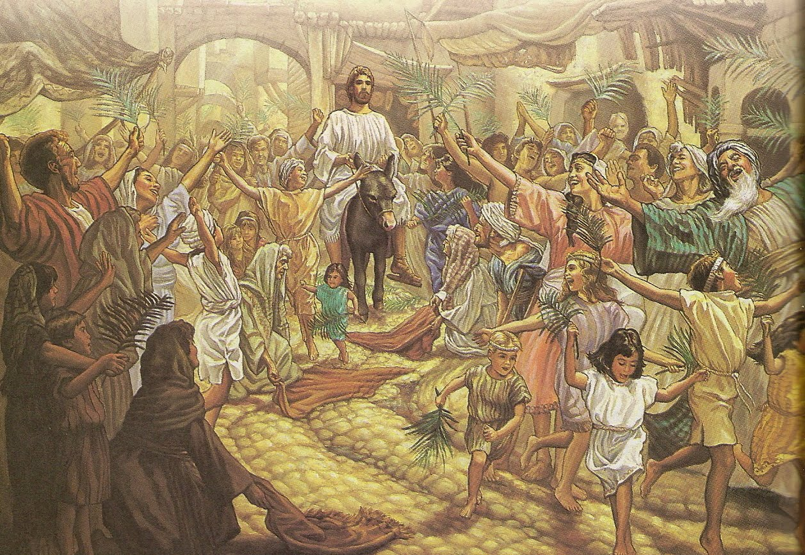

Slide 4
The Bible:
It is made up of 66 different books.
It was written in 3 different languages: Hebrew, Aramaic, and Greek.
It was written over a time period of 1,600 years.
It was written by many different types of people: kings, farmers, fishermen, tentmakers, prophets, scribes
It was written by over 40 different authors
It is the most popular book in the world
It has been translated into more languages than any other book.

Slide 5
8 Specific Prophecies fulfilled by Jesus
Christ would be born in Bethlehem - Micah 5:2
Micah 5:2 "But you, Bethlehem Ephrathah, though you are small among the clans of Judah, out of you will come for me one who will be ruler over Israel, whose origins are from of old, from ancient times."

Slide 6
8 Specific Prophecies fulfilled by Jesus
Christ would be born in Bethlehem - Micah 5:2
He would be preceded by a messenger who would prepare the way for him - Isaiah 40:3, Malachi 3:1
Isaiah 40:3 A voice of one calling: "In the wilderness prepare the way for the LORD; make straight in the desert a highway for our God.
Malachi 3:1 "I will send my messenger, who will prepare the way before me. Then suddenly the LORD you are seeking will come to his temple; the messenger of the covenant, whom you desire, will come," says the LORD Almighty.

Slide 7
8 Specific Prophecies fulfilled by Jesus
Christ would be born in Bethlehem - Micah 5:2
He would be preceded by a messenger who would prepare the way for him - Isaiah 40:3, Malachi 3:1
He would enter Jerusalem riding on a donkey - Zechariah 9:9
Zechariah 9:9 Rejoice greatly, Daughter Zion! Shout, Daughter Jerusalem! See, your king comes to you, righteous and victorious, lowly and riding on a donkey, on a colt, the foal of a donkey.

Slide 8
8 Specific Prophecies fulfilled by Jesus
Christ would be born in Bethlehem - Micah 5:2
He would be preceded by a messenger who would prepare the way for him - Isaiah 40:3, Malachi 3:1
He would enter Jerusalem riding on a donkey - Zechariah 9:9
Betrayed by a friend, wounded on his hands - Zechariah 13:6
Zechariah 13:6 “And someone will say to him, ‘What are these wounds in your hands?’ Then he will answer ‘Those with which I was wounded in the house of my friends.’

Slide 9
8 Specific Prophecies fulfilled by Jesus
Christ would be born in Bethlehem - Micah 5:2
He would be preceded by a messenger who would prepare the way for him - Isaiah 40:3, Malachi 3:1
He would enter Jerusalem riding on a donkey - Zechariah 9:9
Betrayed by a friend, wounded on his hands - Zechariah 13:6
Betrayed for exactly 30 pieces of silver - Zechariah 11:12
Zechariah 11:12 Then I said to them, “If it is agreeable to you, give me my wages; and if not, refrain.” So they weighed out for my wages 30 pieces of silver.

Slide 10
8 Specific Prophecies fulfilled by Jesus
Christ would be born in Bethlehem - Micah 5:2
He would be preceded by a messenger who would prepare the way for him - Isaiah 40:3, Malachi 3:1
He would enter Jerusalem riding on a donkey - Zechariah 9:9
Betrayed by a friend, wounded on his hands - Zechariah 13:6
Betrayed for exactly 30 pieces of silver - Zechariah 11:12
The silver returned, thrown down in the temple, and used to buy a potter's field - Zechariah 11:13
Zechariah 11:13 And the Lord said to me, “Throw it to the potter” – that princely price they set on me. So I took the thirty pieces of silver and threw them into the house of the Lord for the potter.

Slide 11
8 Specific Prophecies fulfilled by Jesus
Christ would be born in Bethlehem - Micah 5:2
He would be preceded by a messenger who would prepare the way for him - Isaiah 40:3, Malachi 3:1
He would enter Jerusalem riding on a donkey - Zechariah 9:9
Betrayed by a friend, wounded on his hands - Zechariah 13:6
Betrayed for exactly 30 pieces of silver - Zechariah 11:12
The silver returned, thrown down in the temple, and used to buy a potter's field - Zechariah 11:13
He would not defend himself before His accusers - Isaiah 53:7
Isaiah 53:7 He was oppressed and afflicted, yet he did not open his mouth; he was led like a lamb to the slaughter, and as a sheep before its shearers is silent, so he did not open his mouth.

Slide 12
8 Specific Prophecies fulfilled by Jesus
Christ would be born in Bethlehem - Micah 5:2
He would be preceded by a messenger who would prepare the way for him - Isaiah 40:3, Malachi 3:1
He would enter Jerusalem riding on a donkey - Zechariah 9:9
Betrayed by a friend, wounded on his hands - Zechariah 13:6
Betrayed for exactly 30 pieces of silver - Zechariah 11:12
The silver returned, thrown down in the temple, and used to buy a potter's field - Zechariah 11:13
He would not defend himself before His accusers - Isaiah 53:7
They would pierce his hands and feet - Psalm 22:16
Psalm 22:16 Dogs surround me, a pack of villains encircles me; they pierce my hands and my feet.

Slide 13
The odds of Jesus fulfilling just 8 of the prophecies given about Him:
1:100,000,000,000,000,000

Slide 14
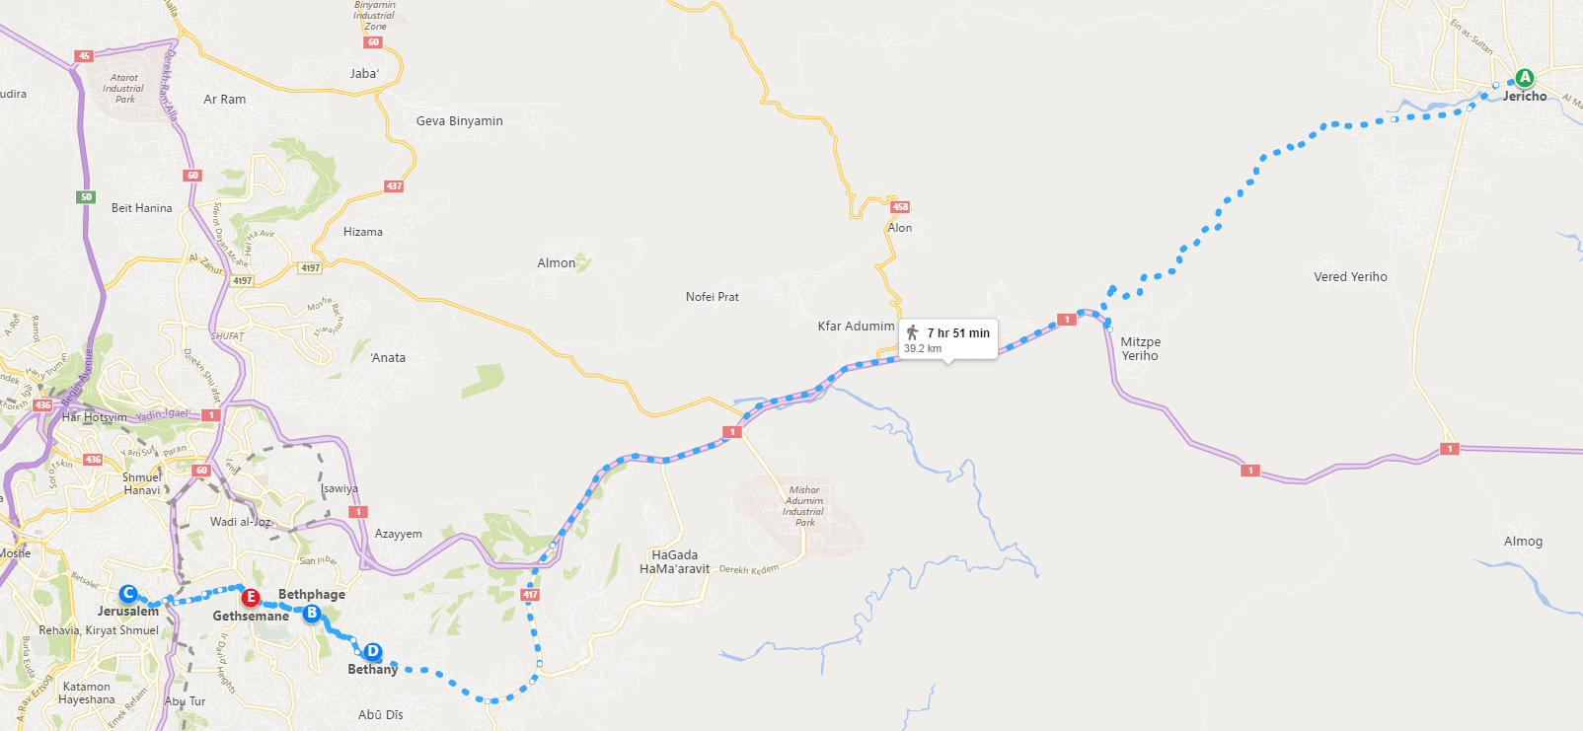

Slide 15
"Therefore My Father loves Me, because I lay down my life that I may take it again.
No one takes it from Me, but I lay it down, and I have power to take it again. This command I have received from My Father." John 10:17 & 18

Slide 16
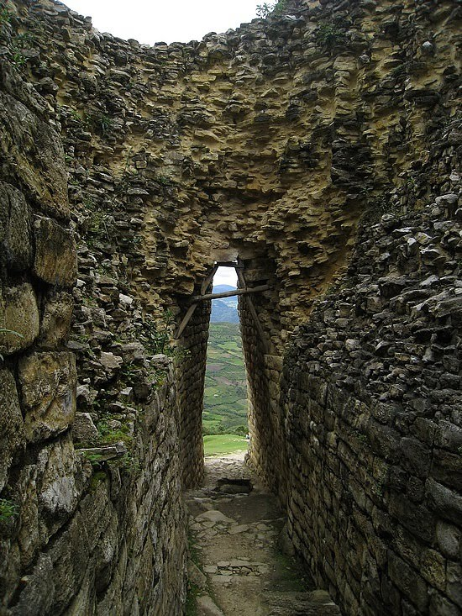
"I am the door. If anyone enters by Me, he will be saved, and will go in and out and find pasture.“ John 10:9
"Enter by the narrow gate; for wide is the gate, and broad is the way that leads to destruction, and there are many who go in by it. Because narrow is the gate and difficult is the way which leads to life, and there are few who find it.“ Matthew 7:13-14

Slide 17
Jesus said to him, "I am the way, the truth, and the life. No one comes to the Father except through Me." John 14:6

Slide 18
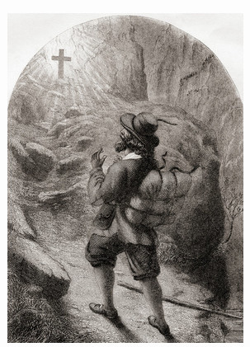
Pilgrim’s burden
Pilgrim at the cross

