Slide 2
GOD GIVES
Acts 8: 32
He who did not spare His own Son, but delivered Him over for us all, how will He
not also with Him freely give us all things?

Slide 3
ACTS 20
33“I have never coveted anyone’s silver or gold or fine clothes. 34You know that these
hands of mine have worked to supply my own needs and even the needs of those who
were with me. 35And I have been a constant example of how you can help those in
need by working hard. You should remember the words of the Lord Jesus: ‘It is more
blessed to give than to receive.’”

Slide 4
MATT 10
5Jesus sent out the twelve apostles with these instructions: “Don’t go to the Gentiles
or the Samaritans, 6but onlyto the people of Israel—God’s lost sheep. 7Go and
announce to them that the Kingdom of Heaven is near.^{d} 8Heal the sick, raise the
dead, cure those with leprosy, and cast out demons.
Give as freely as you have received!

Slide 5
MATT 6
19 “Do not store up for yourselves treasures on earth, where moths and
vermin destroy, and where thieves break in and steal.
20 But store up for yourselves treasures in heaven, where moths and
vermin do not destroy, and where thieves do not break in and steal.
21 For where your treasure is, there your heart will be also.

Slide 6
GIVING IS AN ISSUE OF THE HEART
IS YOUR HEART FOCUSED ON EARTH?
IS IT FOCUSED ON THE KINGDOM?

Slide 7
2 Cor 9
Amount to give
Covetousness
Not under a command
Not reluctantly
Cheerfully

Slide 8
GIVING UNDER THE MOSAIC COVENANT
10%
NUM 18: 21
To the Levites I have given every tithe in Israel for an inheritance, in return for their service that they do, their service in the tent of meeting.”
23%
10%
DEUT 12: 6-7
And there you shall bring your burnt offerings and your sacrifices, your tithes and the contribution that you present, your vow offerings, your freewill offerings, and the firstborn of your herd and of your flock. And there you shall eat before the Lord your God, and you shall rejoice, you and your households, in all that you undertake, in which the Lord your God has blessed you.”
Offering over and above
3%
DEUT 14: 28-29
“At the end of every three years you shall bring out all the tithe of your produce in the same year and lay it up within your towns. And the Levite, because he has no portion or inheritance with you, and the sojourner, the fatherless, and the widow, who are within your towns, shall come and eat and be filled, that the Lord your God may bless you in all the work of your hands that you do.”

Slide 9
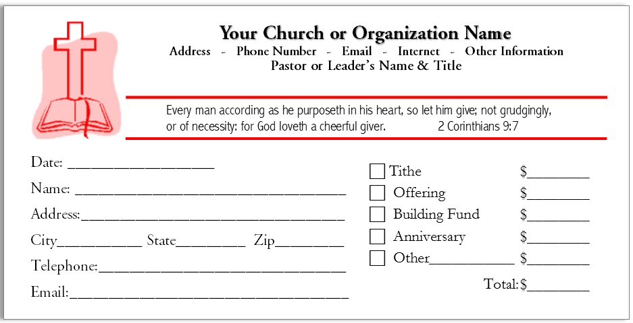
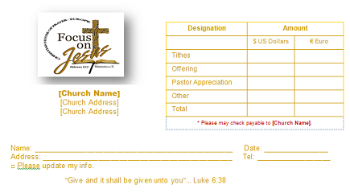

Slide 10
ABRAHAMIC COVENANT
GEN 14
18And Melchizedek, the king of Salem and a priest of God Most High,^{d} brought Abram some bread and
wine. 19Melchizedek blessed Abram with this blessing: “Blessed be Abram by God Most High,
Creator of heaven and earth.20And blessed be God Most High,who has defeated your enemies for you.”
Then Abram gave Melchizedek a tenth of all the goods he had recovered.

Slide 11
Prov 11: 34
One person gives freely, yet gains even more; another withholds unduly, but comes to poverty
Prov 3: 9-10
9Honor the LORD with your wealth and with the firstfruits of all your harvest;
10then your barns will be filled with plenty, and your vats will overflow with new wine.
1 CHRON 29: 9
Then the people rejoiced because they had offered so willingly, for they made their offering to the LORD with a whole heart, and King David also rejoiced greatly.

Slide 12
PRINCIPLES FOR GIVING
1 COR 16
1Now concerning the collection for the saints, as I directed the churches of Galatia, so do you also. 2On the
first day of every week each one of you is to put aside and save, as he may prosper, so that no collections be
made when I come.

Slide 13
WHO HAS GOD CALLED TO THIS REGION?
WHO HAS GOD CALLED TO ADVANCE HIS KINGDOM?
WHO IS GOING TO REACH THE COMMUNITY?
WHO WILL HEAL, BIND UP AND PREACH THE GOSPEL?
WHO IS GOING TO FINANCE IT?

