Slide 2
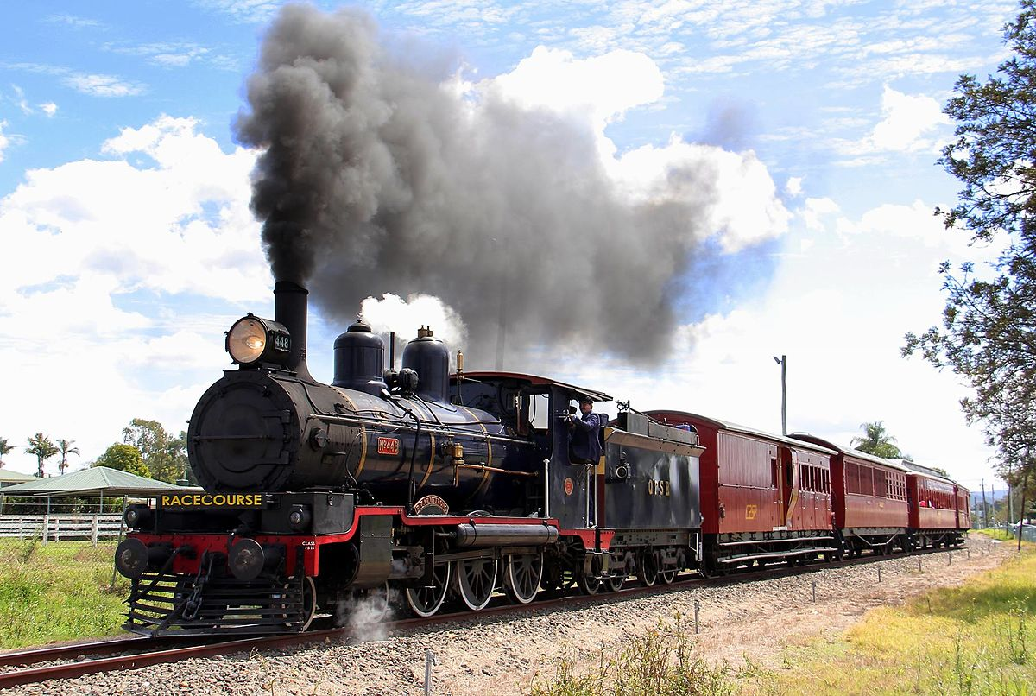
THE TRAIN OF SPIRITUAL DISCIPLINES

Slide 3
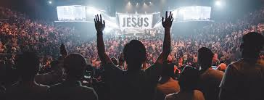
WHAT IS WORSHIP?

Slide 4
GEN 22
1Now it came about after these things, that God tested Abraham, and said to him, “Abraham!” And he
said, “Here I am.” 2He said, “Take now your son, your only son, whom you love, Isaac, and go to the
land of Moriah, and offer him there as a burnt offering on one of the mountains of which I will tell
you.” 3So Abraham rose early in the morning and saddled his donkey, and took two of his young men
with him and Isaac his son; and he split wood for the burnt offering, and arose and went to the place
of which God had told him. 4On the third day Abraham raised his eyes and saw the place from a
distance. 5Abraham said to his young men, “Stay here with the donkey, and I and the lad will go over
there; and we will worship and return to you.”
To bow down

Slide 5
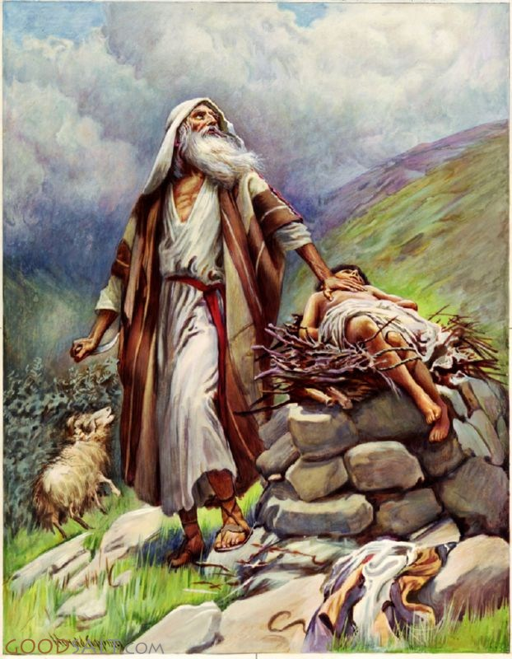
FIRST MENTION OF WORSHIP IN THE BIBLE
WHERE IS THE BAND?
NO FLAGS?
CHOIR?
NOT EVEN A GUITAR?
SONGS?

Slide 6
SPECIFICS OF WHAT GOD WAS TESTING?
HIS HEART
Did the blessing and promises of God eclipse God in Abraham’s heart.
HIS TRUST
What God had promised him. His future. His provider
SACRIFICE
It cost Abraham something.

Slide 7
HEART
Exo 32
8 "They have quickly turned aside from the way which I commanded them. They have made for themselves a molten calf, and have worshiped it and have sacrificed to it and said, 'This is your god, O Israel, who brought you up from the land of Egypt!' "
ISAIAH 29: 13
Then the Lord said, "Because this people draw near with their words And honor Me with their lip service, But they
remove their hearts far from Me, And their reverence for Me consists of tradition learned by rote,

Slide 8
TRUST
GEN 12
2I will make you into a great nation, and I will bless you; I will make your name great, so that you will be a blessing.
3I will bless those who bless you and curse those who curse you; and all the families of the earth will be blessed through you. ”
GEN 17
"But My covenant I will establish with Isaac, whom Sarah will bear to you at this season next year."
HEB 11
17 By faith Abraham, when he was tested, offered up Isaac on the altar. He who had received the promises was ready to offer his one and only son,18even though God had said to him, “Through Isaac your offspring will be reckoned.”b 19Abraham reasoned that God could raise the dead, and in a sense, he did receive Isaac back from death.

Slide 9
SACRIFICE
2 SAM 24
20Araunah looked down and saw the king and his servants crossing over toward him; and Araunah went out and bowed his face to the ground before the king. 21Then Araunah said, “Why has my lord the king come to his servant?” And David said, “To buy the threshing floor from you, in order to build an altar to the LORD, that the plague may be held back from the people.” 22Araunah said to David, “Let my lord the king take and offer up what is good in his sight. Look, the oxen for the burnt offering, the threshing sledges and the yokes of the oxen for the wood. 23“Everything, O king, Araunah gives to the king.” And Araunah said to the king, “May the LORD your God accept you.”24However, the king said to Araunah, “No, but I will surely buy it from you for a price, for I will not offer burnt offerings to the LORD my God which cost me nothing.” So David bought the threshing floor and the oxen for fifty shekels of silver.
ROM 12
1.Therefore I urge you, brethren, by the mercies of God, to present your bodies a living and holy sacrifice, acceptable to God, which is your spiritual service of worship.
HEB 13: 15
Through Him then, let us continually offer up a sacrifice of praise to God, that is, the fruit of lips that give thanks to His name.

Slide 10
WHY IS WORSHIP SO IMPORTANT? WHO OR WHAT YOU WORSHIP IS ALSO WHAT YOU SERVE.
EXODUS 23
24“You shall not worship their gods, nor serve them, nor do according to their deeds; but you shall utterly overthrow them and break their sacred pillars in pieces. 25“But you shall serve the LORD your God, and He will bless your bread and your water; and I will remove sickness from your midst
Deut 4
19 "And beware not to lift up your eyes to heaven and see the sun and the moon and the stars, all the host of heaven, and be drawn away and worship them and serve them, those which the LORD your God has allotted to all the peoples under the whole heaven.

Slide 11
1 KINGS 11
1Now King Solomon loved many foreign women along with the daughter of Pharaoh: Moabite, Ammonite, Edomite,
Sidonian, and Hittite women,2from the nations concerning which the LORD had said to the sons of Israel, “You shall not
associate with them, nor shall they associate with you, for they will surely turn your heart away after their gods.” Solomon
held fast to these in love. 3He had seven hundred wives, princesses, and three hundred concubines, and his wives turned his
heart away. 4For when Solomon was old, his wives turned his heart away after other gods; and his heart was not wholly
devoted to the LORD his God, as the heart of David his father had been. 5For Solomon went after Ashtoreth the goddess \
of the Sidonians and after Milcom the detestable idol of the Ammonites. 6Solomon did what was evil in the sight of the
LORD, and did not follow the LORD fully, as David his father had done. 7Then Solomon built a high place for Chemosh the
detestable idol of Moab, on the mountain which is east of Jerusalem, and for Molech the detestable idol of the sons of
Ammon. 8Thus also he did for all his foreign wives, who burned incense and sacrificed to their gods.

Slide 12
WORSHIP ENCOMPASSES ALL OF OUR LIVES…WE LIVE A LIFESTYLE OF WORSHIP TO THE LORD
JOHN 4
23“But an hour is coming, and now is, when the true worshipers will worship the Father in spirit and truth; for such people the Father seeks to be His worshipers. 24“God is spirit, and those who worship Him must worship in spirit and truth.”

Slide 13
1 Chron 16
23 Sing to the LORD, all the earth; proclaim his salvation day after day.
24 Declare his glory among the nations, his marvelous deeds among all peoples.
25 For great is the LORD and most worthy of praise; he is to be feared above all gods.
26 For all the gods of the nations are idols, but the LORD made the heavens.
27 Splendor and majesty are before him; strength and joy are in his dwelling place.
28Ascribe to the LORD, all you families of nations, ascribe to the LORD glory and strength.
29 Ascribe to the LORD the glory due his name; bring an offering and come before him. Worship the LORD in the splendor of his holiness.
30 Tremble before him, all the earth! The world is firmly established; it cannot be moved.
31 Let the heavens rejoice, let the earth be glad; let them say among the nations, “The LORD reigns!”

